Slide 1


S.2014.6933576.z
Travelling Salesman Problem using Dynamic Programming and Nearest Neighbor
Guidance & Evaluation by Prof. Kazi Islam
C. Ye, Z. Yang and T. Yan, "An efficient and scalable algorithm for the traveling salesman problem," 2014 IEEE 5th International Conference on Software Engineering and Service Science, Beijing, China, 2014, pp. 335-339, doi: 10.1109/ICSESS.2014.6933576.z

Slide 2
Team Member | Roles and Responsibilities
Aditi Patil
Vinoothna Dudam
Sai Sanjay Potluri
Chinmayee Krishna Sriramoju
Hema Kanjula

Slide 3


Problem Statement
Optimizing the traditional Travelling Salesman Problem’s algorithm using dynamic programming and nearest neighbor. We will take a public dataset containing the geographical coordinates of cities and calculate the shortest distance between all the cities in the TSP dataset. The motivation behind this project stems from the need to enhance the efficiency of traditional TSP algorithms, which are computationally intensive, particularly as the number of cities increases and reduce the shortest distance between them. The goal is to efficiently reduce the computational time required to find the shortest path between all cities, and output the shortest distance as the result.

Slide 4

Introduction

Slide 5

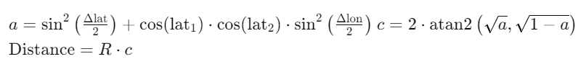
Haversine Distance
Calculates the distance between two points on the surface of a sphere, considering its curvature
Commonly used in navigation, geolocation.
The Haversine formula is expressed as follows:
where,
Δlat and Δlon are the differences in latitudes and longitudes between the two points.
R is the Earth's radius (mean radius ≈ 6371 km).
More accurate distance compared to Euclidean calculations.

Slide 6

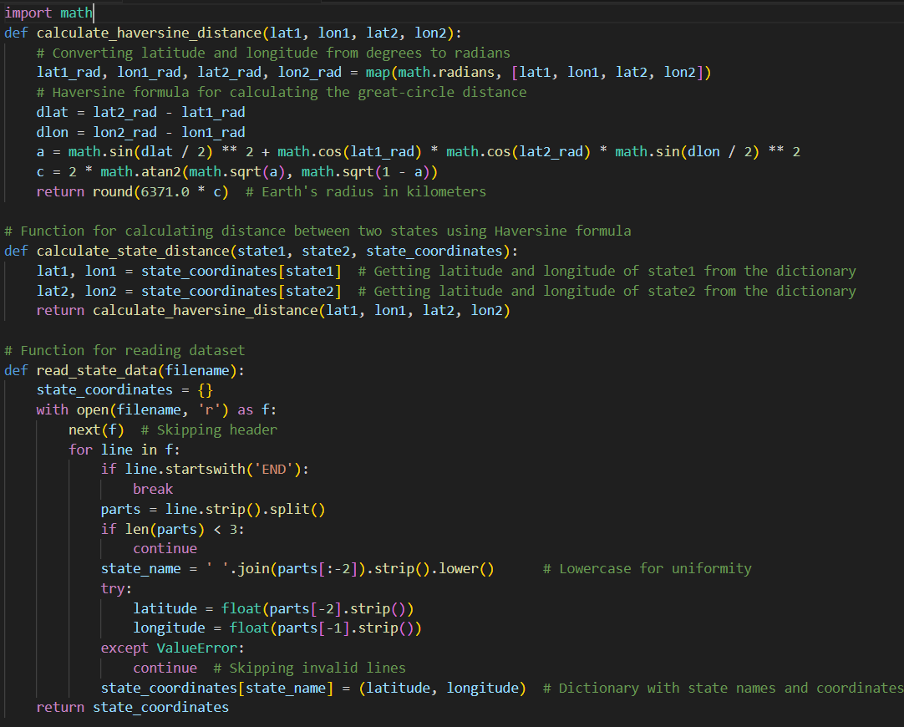
Dataset Description
Contains information about 50 U.S. states
Includes names and geographical coordinates
The dataset was chosen , as it provides the necessary geographical information to compute distances between various locations

Slide 7
Nearest Neighbor
The Nearest Neighbor Algorithm is an opmistic method for solving the Traveling Salesman Problem (TSP). The algorithm works by starting at a random city and repeatedly choosing the closest unvisited city until all cities have been visited. The algorithm then returns to the starting city to complete the tour. The Nearest Neighbor Algorithm has several advantages, including being memory efficient, requiring minimal memory, and being suitable for environments with limited memory resources. Additionally, the algorithm has transparent decision-making, is straightforward and easy to understand, and has incremental update capability, allowing it to adopt changes without requiring a complete re-run. The Nearest Neighbor Algorithm is a greedy algorithm, making the locally optimal choice at each step with the intent of finding the overall optimal solution.

Slide 8
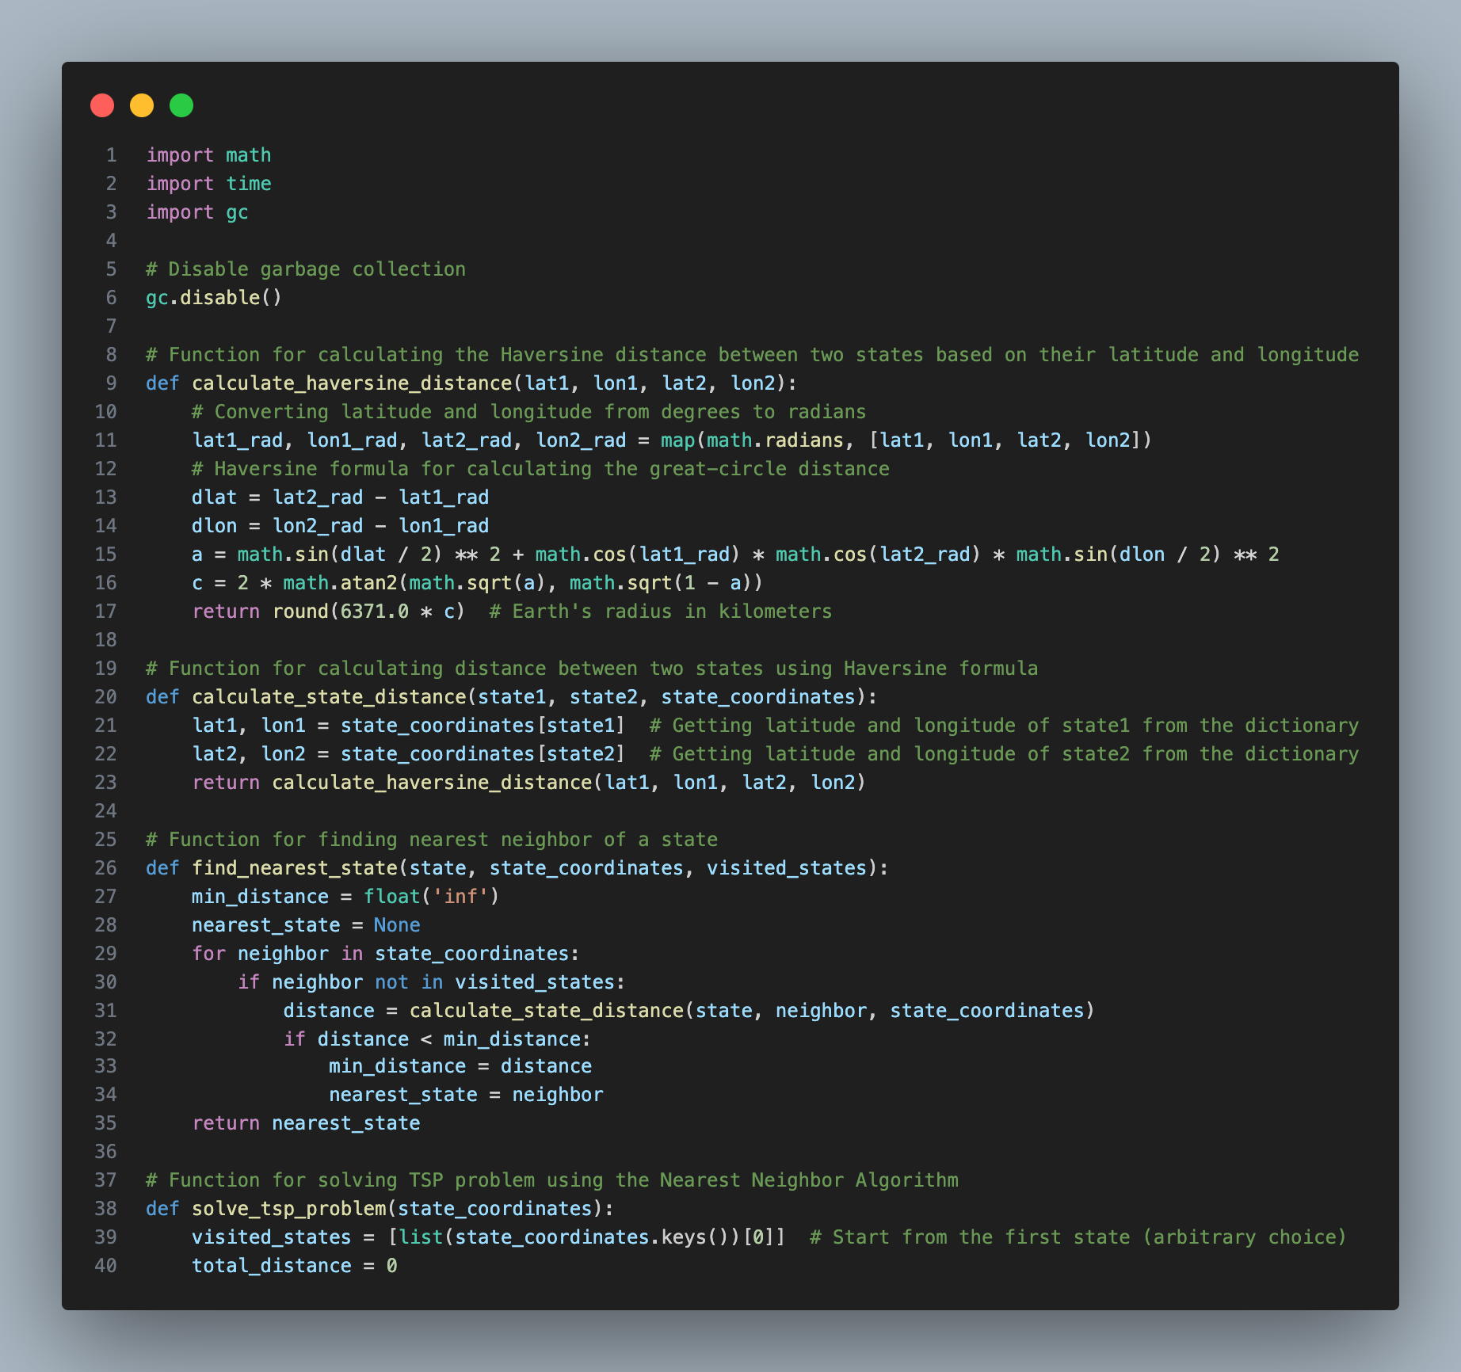
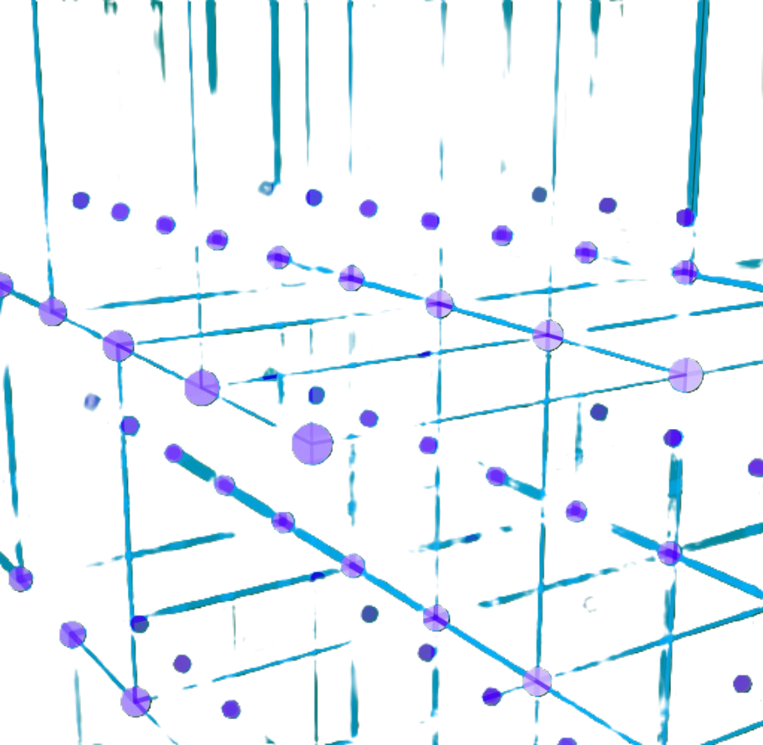
Nearest Neighbor Code

Slide 9
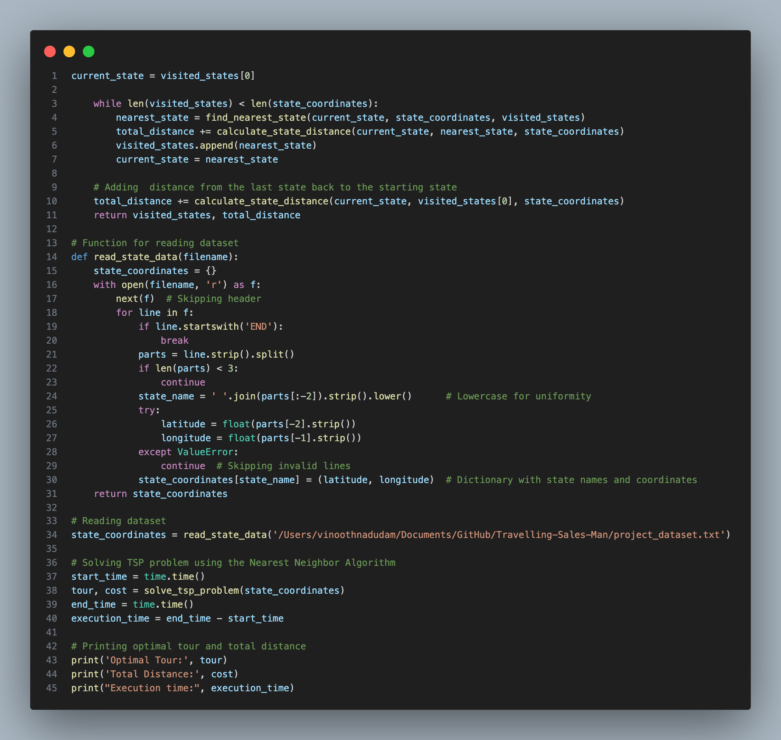
Nearest Neighbor Code

Slide 10

2-Opt Optimisation Algorithm
The 2-opt algorithm is a local optimization technique often used to improve a TSP solution obtained by a heuristic like Nearest Neighbor. It works by:
Selecting two edges in the current tour.
Reversing the order of the nodes between those two edges to see if the new tour is shorter.
Repeating this process until no further improvements can be made.
Incorporating 2-opt into the solution, would involve adding a separate step after generating the initial tour with the Nearest Neighbor Algorithm to check and swap edges for potential improvements.

Slide 11

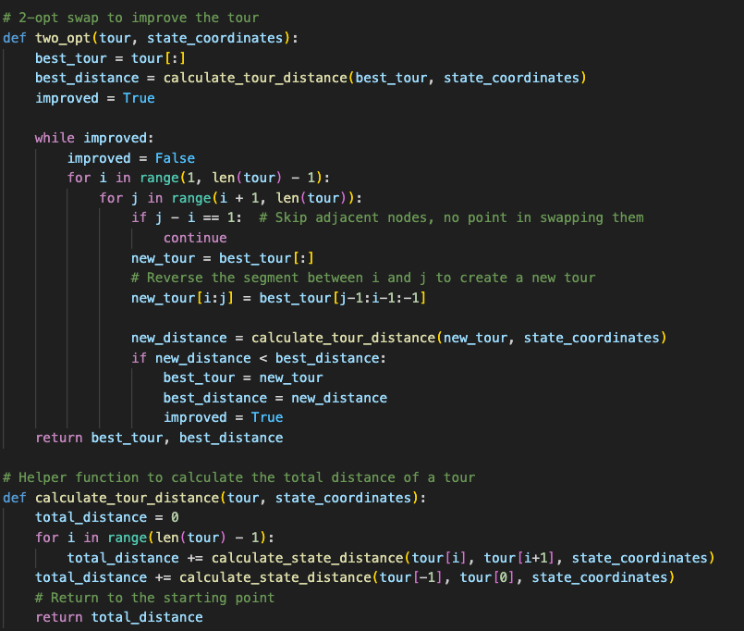
2-Opt Optimisation
Steps:
Initial Tour with Nearest Neighbor Algorithm: You already have this.
2-opt Optimization:
For each pair of edges in the tour, we check if swapping them reduces the total distance.
If a swap improves the distance, we update the tour.
This process is repeated until no further improvement can be made.

Slide 12

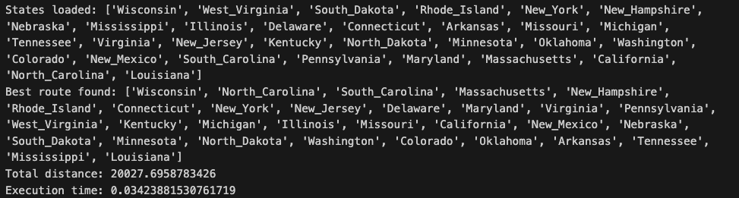
Outputs and Implementation
Initial output

Slide 13
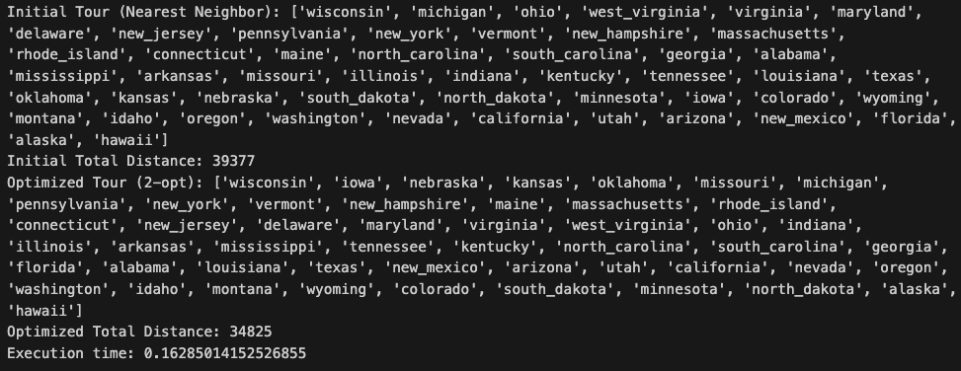
Outputs and Implementation
Optimized output

Slide 14

Progress Report
Current Progress:
Successfully developed Nearest Neighbor and 2-opt algorithms
Tested on dataset of the geographical locations showing promising results
Comprehensive performance evaluation conducted on dataset
Achieved good performance but requires further improvement in terms of time complexity and overall efficiency
Identified areas for improvement in terms of time and space efficiency

Slide 15
Performance Evaluation
Time and Space Complexity:
Algorithm | Best Time Complexity | Worst Time Complexity | Average Time Complexity | Space Complexity
Nearest Neighbor | O(n²) | O(n²) | O(n²) | O(n)
2-opt | O(n²) | O(n³) | O(n³) | O(n)

Slide 16

Prognosis and Future Work
Investigate advanced techniques to reduce time and space complexity
Implement Dynamic programming solution to solve TSP (Travelling Salesman Problem)
Optimize Dynamic programming solution if required
Analyze complexity and test Dynamic programming solution with small to medium size dataset
Compare Dynamic programming solution with nearest neighbor and 2-opt solution
Identify strengths and weaknesses of each algorithmic solution
Implement necessary final adjustments based on testing feedback
Write comprehensive documentation

Slide 17

References
Y. Wang, "A Nearest Neighbor Method with a Frequency Graph for Traveling Salesman Problem," 2014 Sixth International Conference on Intelligent Human-Machine Systems and Cybernetics, Hangzhou, China, 2014, pp. 335-338, doi: 10.1109/IHMSC.2014.88.
D.S. Johnson and L.A. McGeoch, “The Traveling Salesman Problem: A Case Study in Local Optimization”, November 20, 1995.
F. Nuriyeva, "Heuristic Algorithm for Solving Travelling Salesman Problem: Adding the Endpoints of the Longest Edges," 2023 5th International Conference on Problems of Cybernetics and Informatics (PCI), Baku, Azerbaijan, 2023, pp. 1-4, doi: 10.1109/PCI60110.2023.10325958.
E. O. Asani, A. E. Okeyinka and A. A. Adebiyi, "A Construction Tour Technique For Solving The Travelling Salesman Problem Based On Convex Hull And Nearest Neighbour Heuristics," 2020 International Conference in Mathematics, Computer Engineering and Computer Science (ICMCECS), Ayobo, Nigeria, 2020, pp. 1-4, doi: 10.1109/ICMCECS47690.2020.240847.
K. Rocki and R. Suda, "Accelerating 2-opt and 3-opt Local Search Using GPU in the Travelling Salesman Problem," 2012 12th IEEE/ACM International Symposium on Cluster, Cloud and Grid Computing (ccgrid 2012), Ottawa, ON, Canada, 2012, pp. 705-706, doi: 10.1109/CCGrid.2012.133.
I. Mavroidis, I. Papaefstathiou and D. Pnevmatikatos, "Hardware Implementation of 2-Opt Local Search Algorithm for the Traveling Salesman Problem," 18th IEEE/IFIP International Workshop on Rapid System Prototyping (RSP '07), Porto alegre, Brazil, 2007, pp. 41-47, doi: 10.1109/RSP.2007.24.
Y. Zhang, C. Wang, H. Li, X. Su, M. Zhao and N. Zhang, "An Improved 2-Opt and ACO Hybrid Algorithm for TSP," 2018 Eighth International Conference on Instrumentation & Measurement, Computer, Communication and Control (IMCCC), Harbin, China, 2018, pp. 547-552, doi: 10.1109/IMCCC.2018.00121.

Slide 18
THANK YOU

